Slide 1
Graph Neural Networks
for Molecular Property Prediction
Hyeokmin Lee & Hyoeun Lim

Slide 2
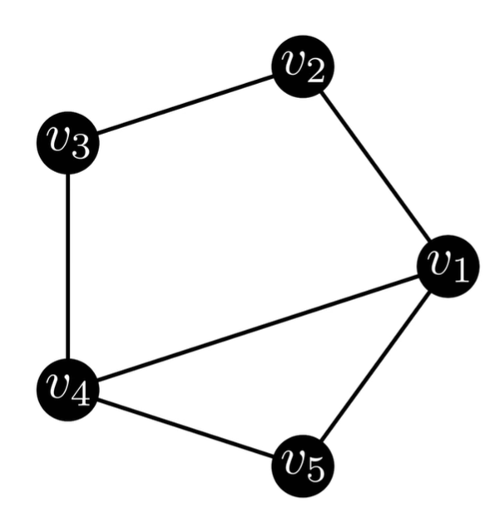
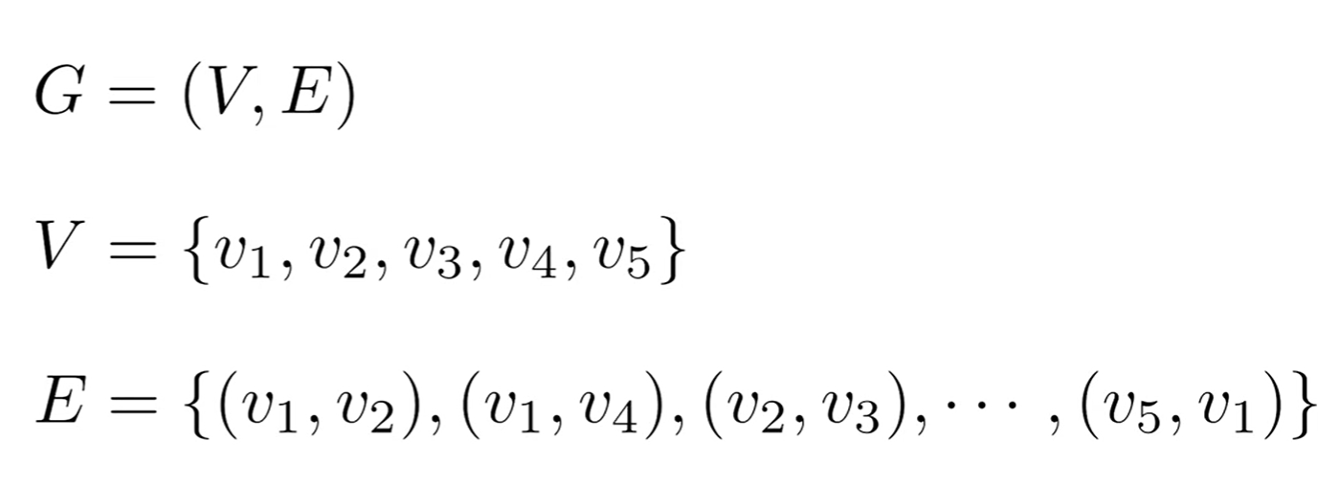
What are graphs?
A graph is a set of vertices (V) and edges (E).
The relationship between vertices are represented by edges.
Ron & Math, "Spectral Graph Theory For Dummies," YouTube (2024)

Slide 3
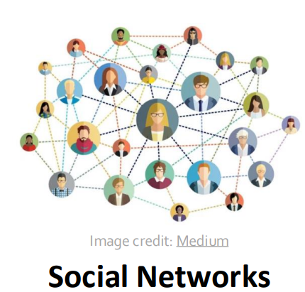
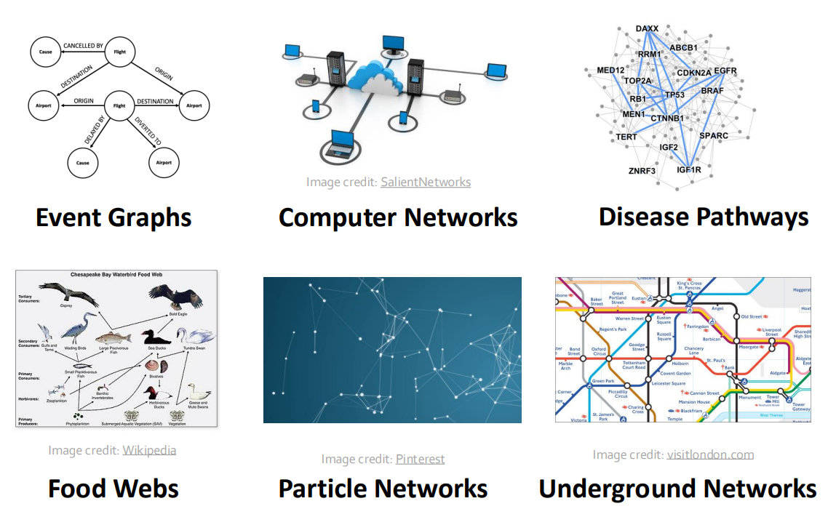
Why graphs?
Jure Leskovec, Stanford CS224W: Machine Learning with Graphs (Fall 2025)

Slide 4
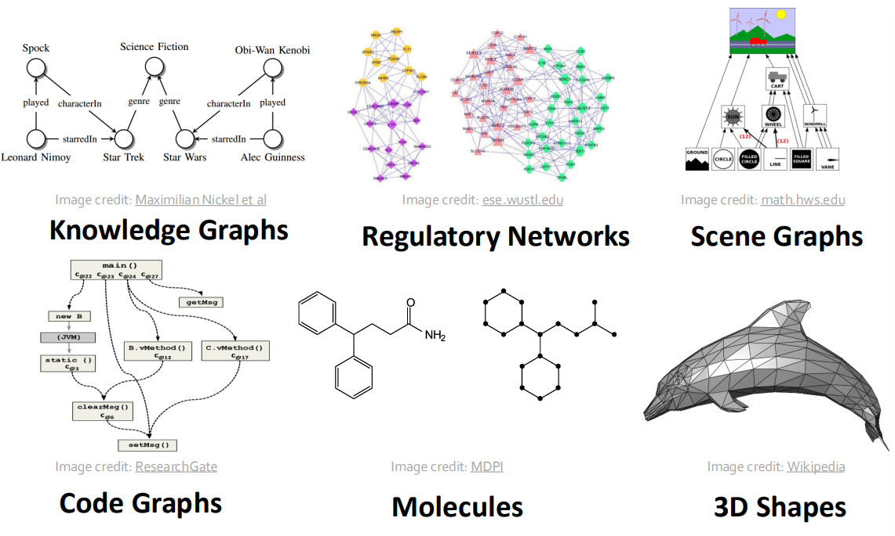
Why graphs?
Jure Leskovec, Stanford CS224W: Machine Learning with Graphs (Fall 2025)

Slide 5
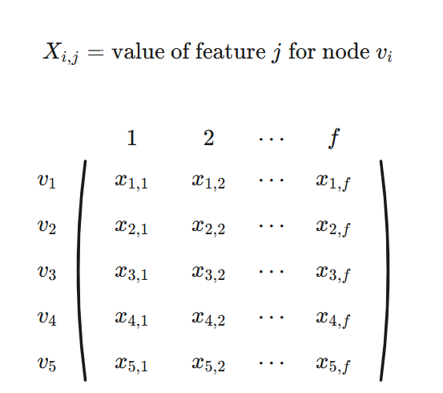
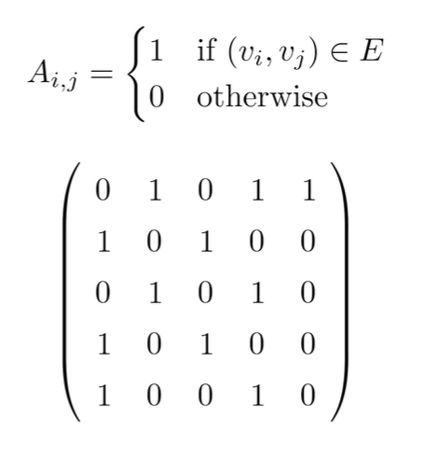
How are graphs represented in discrete form?
Feature matrix
Ron & Math, "Spectral Graph Theory For Dummies," YouTube (2024)

Slide 6
How are graphs represented in discrete form?
Adjacency matrix
Ron & Math, "Spectral Graph Theory For Dummies," YouTube (2024)

Slide 7
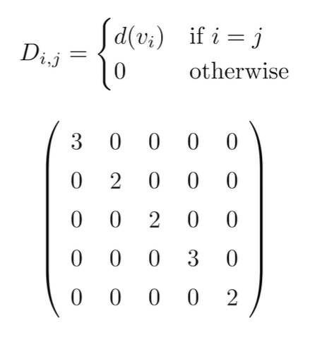
How are graphs represented in discrete form?
Degree matrix
Ron & Math, "Spectral Graph Theory For Dummies," YouTube (2024)

Slide 8
Pipeline
SMILES string
RDkit
passing
GCN layers
Readout & MLP
Predicted property

Slide 9
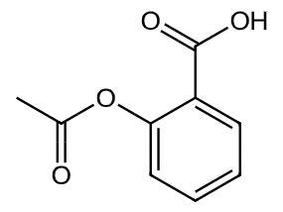
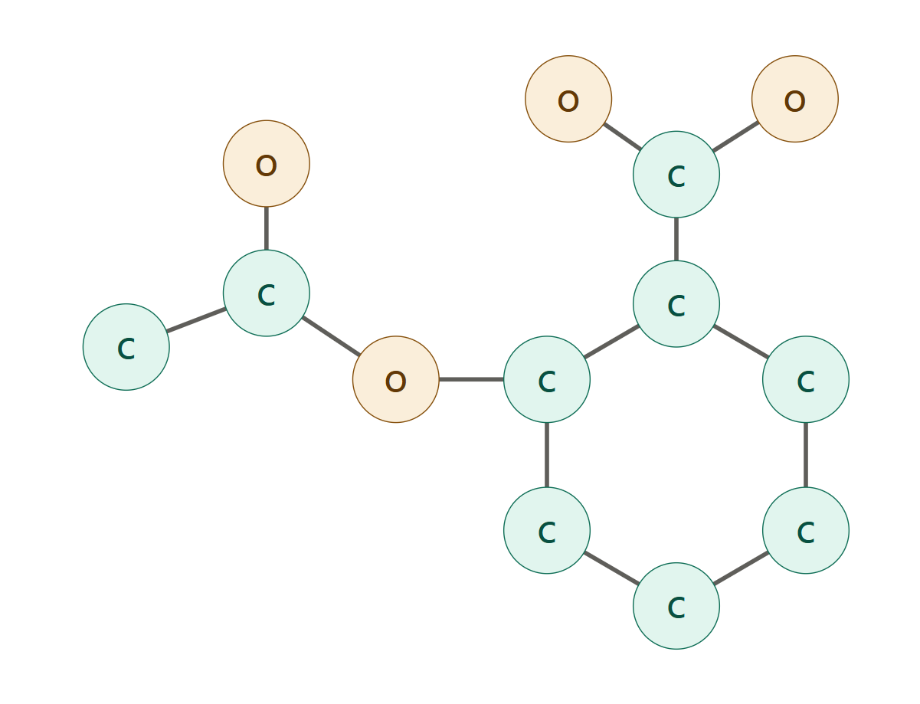
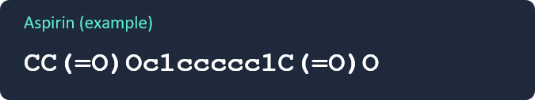
From SMILES to a Molecular Graph
STEP 1 · CONVERSION
<SMILES>
<Molecular Structure>
<Molecular Graph>
Parse ➡ Featurize ➡ Build the graph (G = (V, E))

Slide 10
How a Graph Convolution Layer Works
STEP 2 · THE GCN LAYER
Layer-wise propagation rule
Adjacency matrix
features
Weight
H_{l}
Number of features
Next layer (H_{l+1})
atoms
h₁
h₆
h₂
Atom v aggregates messages
from its bonded neighbors
h_{v}
h₅
h₄
h₃
Kipf & Welling, "Semi-Supervised Classification with Graph Convolutional Networks", ICLR 2017

Slide 11
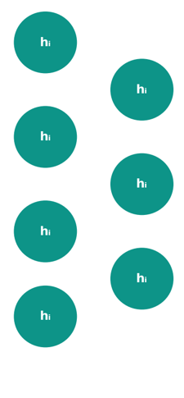
Pooling Atoms into One Prediction
STEP 3· READOUT
Atom embeddings
h_{g}
(graph vector)
MLP
Property
mean
Global pooling
2~3 layers
solubility, toxicity, binding affinity, etc.
Permutation invariance
mean pooling gives the same result no matter how atoms are ordered
Kipf & Welling, "Semi-Supervised Classification with Graph Convolutional Networks", ICLR 2017

Slide 12
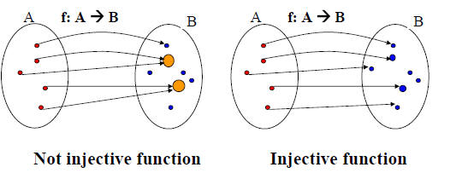
Injectivity
Injective function maps distinct elements of its domain to distinct elements of its codomain.

Slide 13
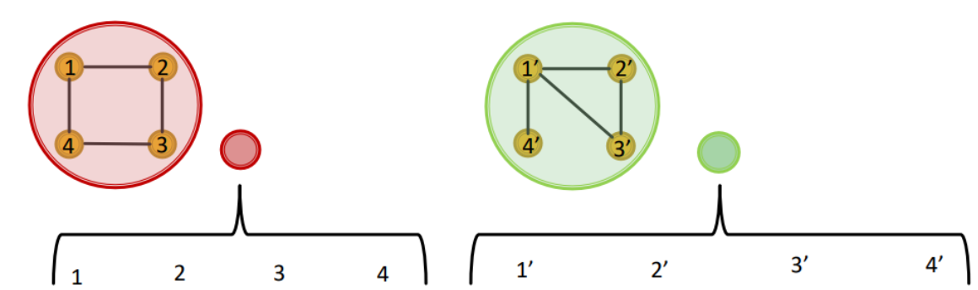
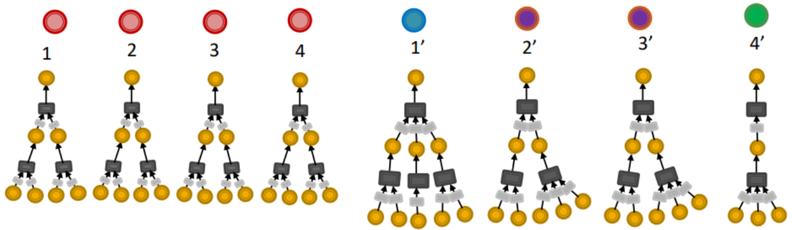
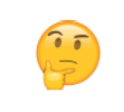
Graph structure vulnerability (non-injectivity)
Assuming input node features are uniform, some simple graph structures cannot be distinguished by GCN.
GCN
Desired
Jure Leskovec, Stanford CS224W: Machine Learning with Graphs (Fall 2019)

Slide 14
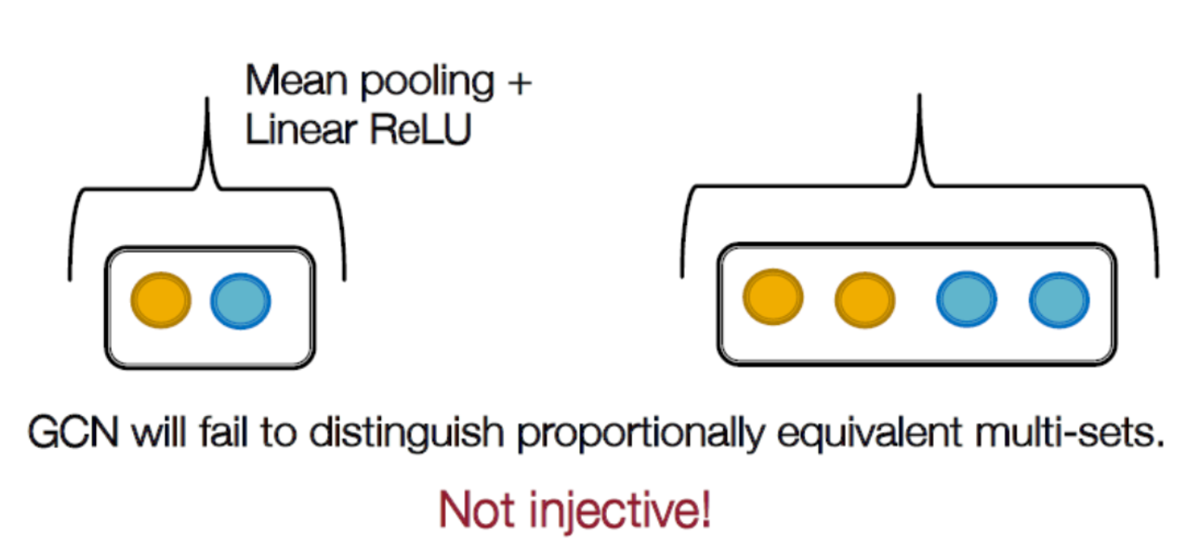
Graph structure vulnerability (non-injectivity)
Jure Leskovec, Stanford CS224W: Machine Learning with Graphs (Fall 2019)

Slide 15
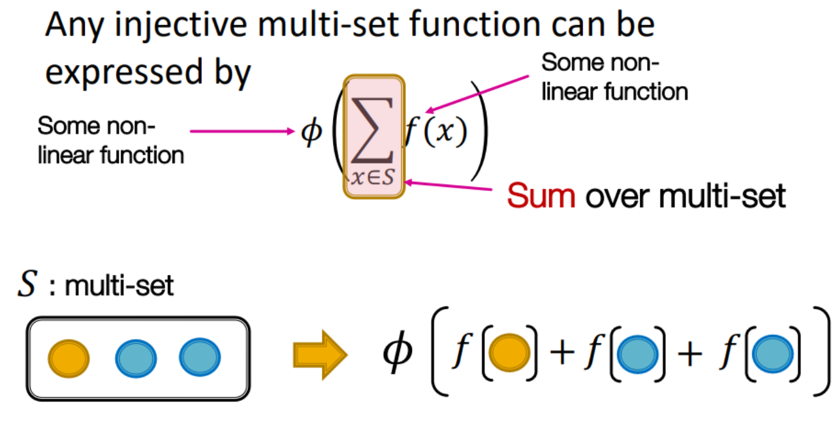
Graph Isomorphism Networks (GIN)
Solution: Model an injective multi-set function for aggregation.
MLP is an universal approximator (Hornik et al., 1989; Hornik, 1991).
Φ and f are modelled by MLP.
Jure Leskovec, Stanford CS224W: Machine Learning with Graphs (Fall 2019)

Slide 16
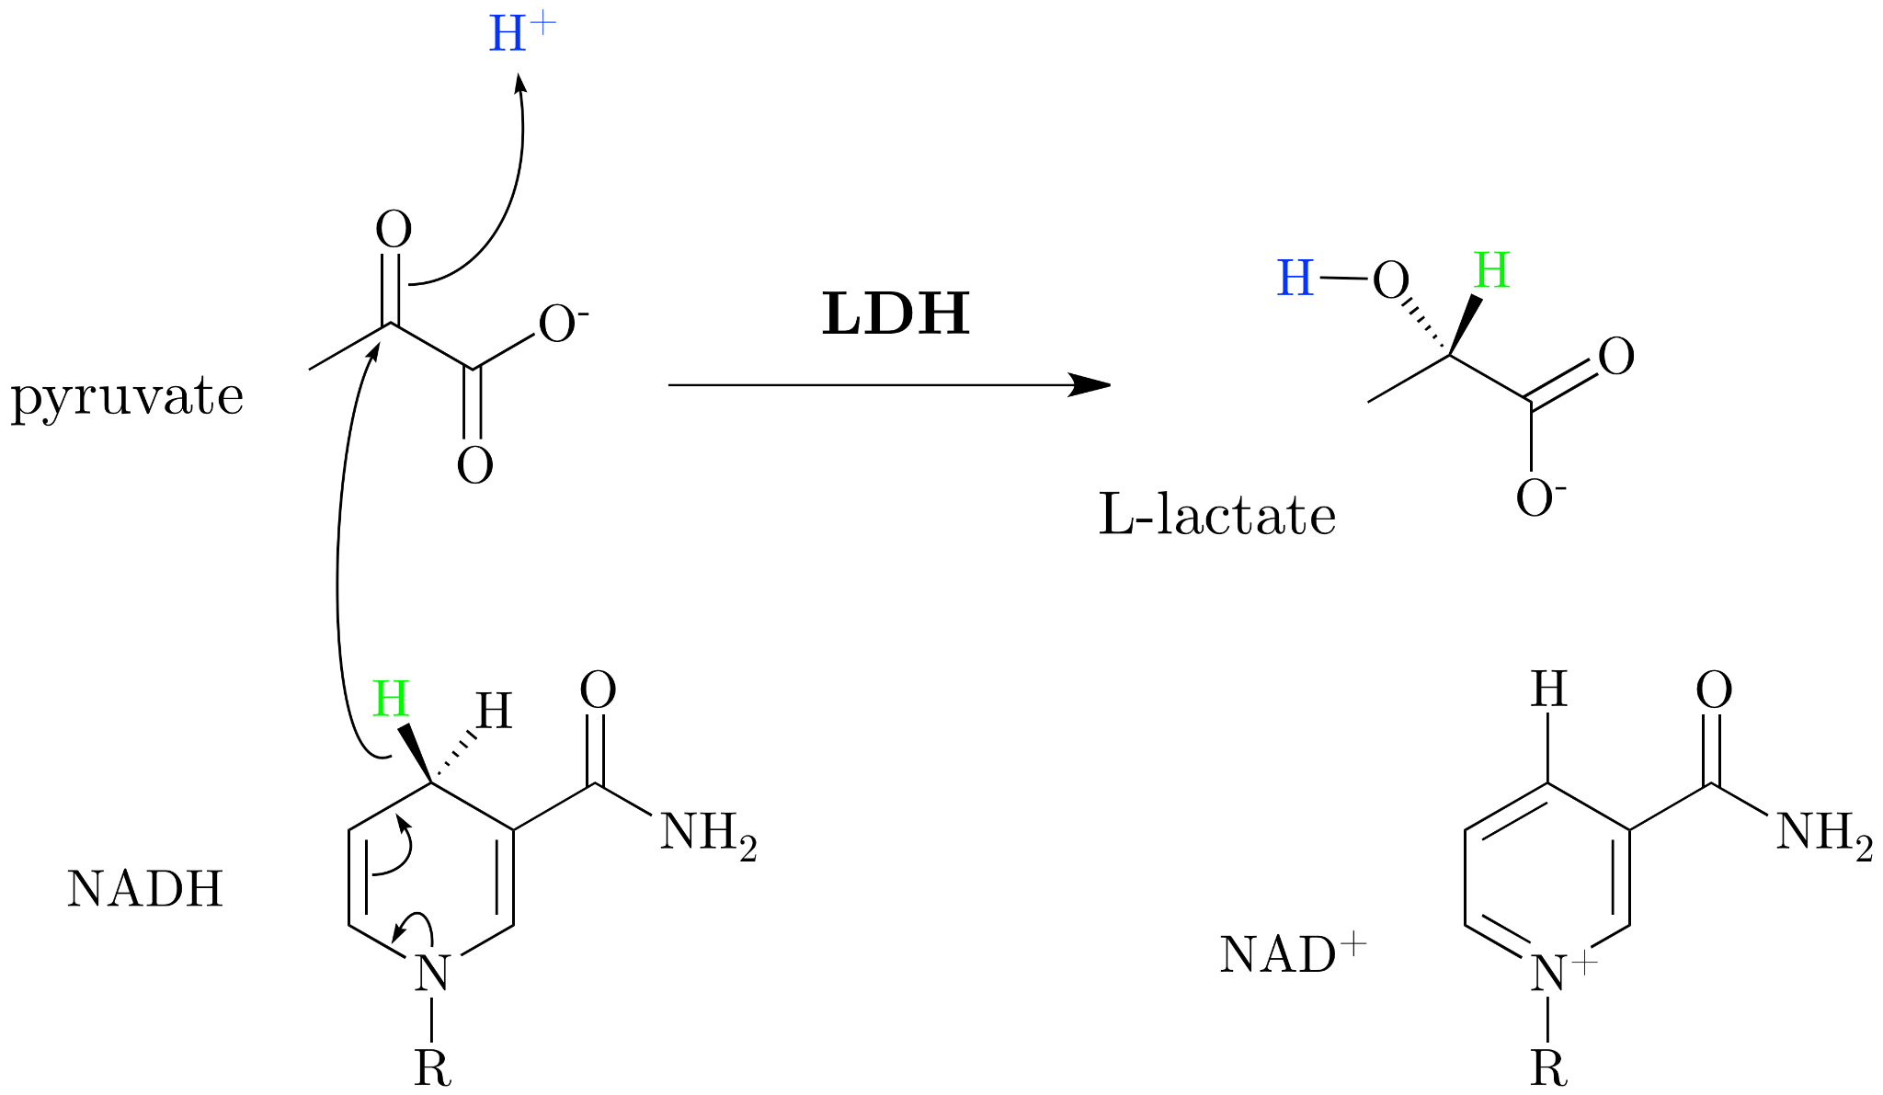
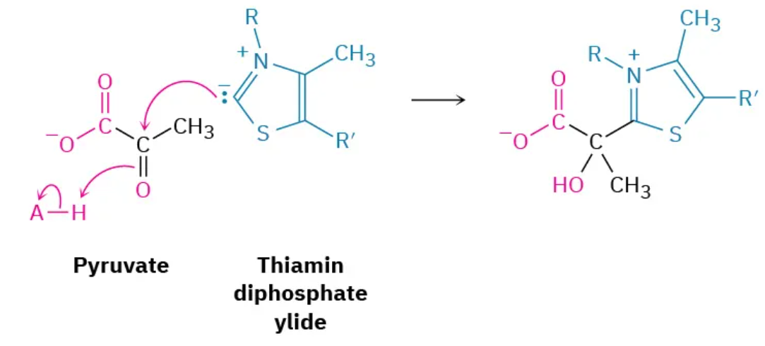
Graph Attention Networks (GAT)
Problem: GCN gives every neighbor an equal vote, no matter what information (feature) it carries.
Nucleophilic attack on 2-carbon during the formation of acetyl-CoA
Nucleophilic attack on 2-carbon during the lactic acid fermentation
Veličković et al., "Graph Attention Networks", ICLR 2018

Slide 17
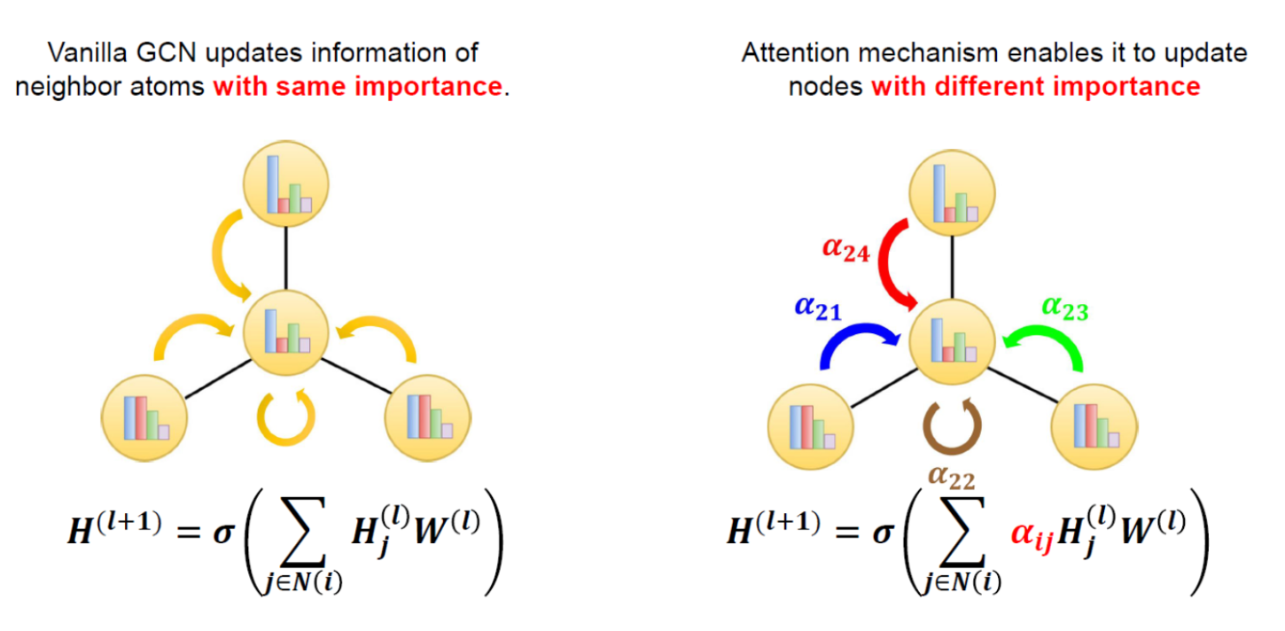
Graph Attention Networks (GAT)
α₂₁ + α₂₂ + α₂₃ + α₂₄= 1, 0 ≤ α_{ij} ≤ 1 by softmax()
Ryu et al., "Deeply Learning Molecular Structure-Property Relationships Using Attention- and Gate-Augmented Graph Convolutional Network", arXiv 2018, Veličković et al., "Graph Attention Networks", ICLR 2018

Slide 18
References
Hornik, K. (1991). Approximation capabilities of multilayer feedforward networks. Neural Networks, 4(2), 251–257. https://doi.org/10.1016/0893-6080(91)90009-T
Hornik, K., Stinchcombe, M., & White, H. (1989). Multilayer feedforward networks are universal approximators. Neural Networks, 2(5), 359–366. https://doi.org/10.1016/0893-6080(89)90020-8
Kipf, T. N., & Welling, M. (2017). Semi-supervised classification with graph convolutional networks. In Proceedings of the 5th International Conference on Learning Representations (ICLR 2017). https://doi.org/10.48550/arXiv.1609.02907
Leskovec, J., & Hu, W. (2019). CS224W: Machine learning with graphs — Limitations of GNNs [Lecture slides]. Stanford University. https://snap.stanford.edu/class/cs224w-2019/slides/18-limitations.pdf
Leskovec, J., & Kanatsoulis, C. (2025). CS224W: Machine learning with graphs — Introduction [Lecture slides]. Stanford University. https://snap.stanford.edu/class/cs224w-2025/slides/01-intro.pdf
Ron & Math. (2024, May 16). Spectral graph theory for dummies [Video]. YouTube. https://www.youtube.com/watch?v=uTUVhsxdGS8
Ryu, S., Lim, J., Hong, S. H., & Kim, W. Y. (2018). Deeply learning molecular structure-property relationships using attention- and gate-augmented graph convolutional network. arXiv. https://doi.org/10.48550/arXiv.1805.10988
Veličković, P., Cucurull, G., Casanova, A., Romero, A., Liò, P., & Bengio, Y. (2018). Graph attention networks. In Proceedings of the 6th International Conference on Learning Representations (ICLR 2018). https://doi.org/10.48550/arXiv.1710.10903
Xu, K., Hu, W., Leskovec, J., & Jegelka, S. (2019). How powerful are graph neural networks? In Proceedings of the 7th International Conference on Learning Representations (ICLR 2019). https://doi.org/10.48550/arXiv.1810.00826

Slide 19
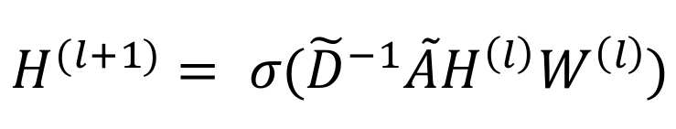
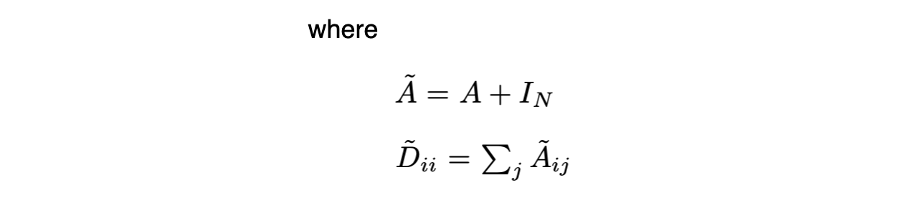
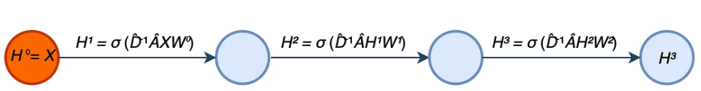
Layer-wise propagation rule
Kipf & Welling, "Semi-Supervised Classification with Graph Convolutional Networks", ICLR 2017

Slide 20
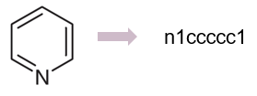
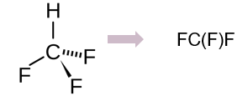
SMILES
Sign | Description
. | Not bonded
- | Single bond
= | Double bond
# | Triple bond
$ | Quadruple bond
: | Aromaticity
/ | Trans structure
\ | Cis structure
Xn | Ring structure
() | Branch
Uppercase | Aliphatic atoms
Lowercase | Aromatic atoms
- H(hydrogen) is ignored
- ex.

Slide 21
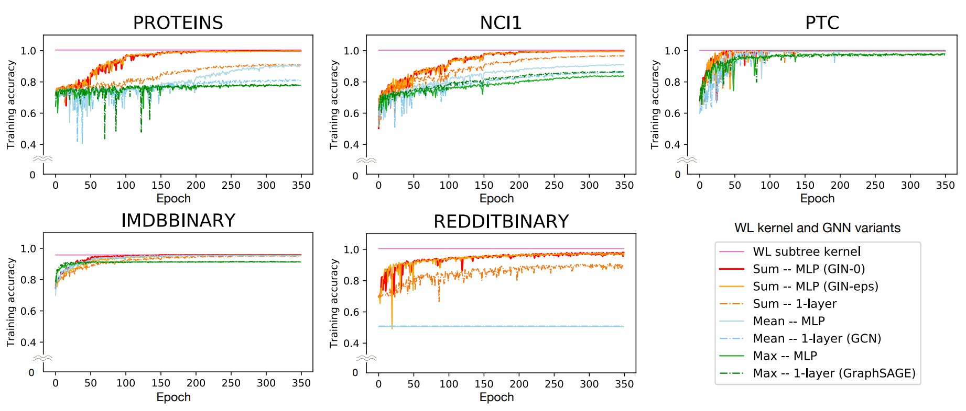
Graph Isomorphism Networks (GIN)
Training set performance of GINs, less powerful GNN variants, and the WL subtree kernel
Xu, Hu, Leskovec & Jegelka, "How Powerful are Graph Neural Networks?", ICLR 2019

Slide 22
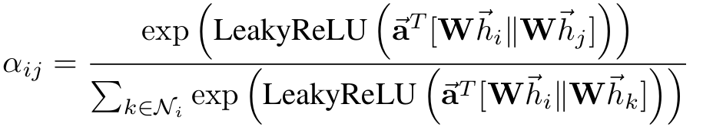
Graph Attention Networks (GAT)
Ryu et al., "Deeply Learning Molecular Structure-Property Relationships Using Attention- and Gate-Augmented Graph Convolutional Network", arXiv 2018, Veličković et al., "Graph Attention Networks", ICLR 2018

